Slide 1
Multiple file project management & Makefile

Slide 2
Compilation & linkage
Compilation:
gcc … -c read.c main.c list.c
Linkage:
gcc ... read.o main.o list.o -o prog1
read.c
read.h
main.c
list.h
list.c
read.o
main.o
list.o
prog1

Slide 3
Compilation & linkage
read.c
read.h
main.c
list.h
list.c
read.o
main.o
list.o
prog1

Slide 4
Compilation & linkage
If only one file is modified, will we have to recompile all over again?
No!
Dependencies tree

Slide 5
Example
read.c
read.h
main.c
list.h
list.c
read.o
main.o
list.o
prog1

Slide 6
(gnu) make

Slide 7
(gnu) make
make is a program who’s main aim is to update other programs in a “smart” way.
“smart” =
Build only out-of-date files (use timestamps).
Use the dependency graph for this.
You tell make what to do by writing a “makefile”

Slide 8
makefile names
make looks automatically for : makefile, Makefile
Override by using –f :
make –f MyMakefile

Slide 9
What makefile contains
Explicit rules
Implicit rules
Variables/MACROS definitions
Comments

Slide 10
Makefile
Aim: Build only out-of-date files (use timestamps)
Makefile contains:
List of dependencies (no cycles)
“Recovery” scenario when any file is modified
main.o: main.c list.h read.h gcc -c main.c
In words: if any of the files {main.c, list.h, read.h} was modified after main.o, the command “gcc -c main.c” will be performed
Beware of the essential tab!

Slide 11
Explicit rules
Rule Syntax:
targets : prerequisites <tab> shell command <tab> ...
Targets: Usually files
Prerequisites: Other files (or targets) that the targets depend on
Command: What to execute (shell command)
<tab> tells make it’s a command
Notes:
A rule appears in the makefile and says when and how to remake certain files, called the rule's targets (most often only one per rule). It lists the other files that are the prerequisites of the target, and commands to use to create or update the target.

Slide 12
How make works?
Given a target:
Find the rule for it
Check if the rule prerequisites are up to date
By “recursive” application on each of them
If one of the prerequisites is newer than target run the command in rule body.
Use the flag <-n> to print the commands being performed.

Slide 13
Dependencies Tree
read.c
read.h
main.c
list.h
list.c
read.o
main.o
list.o
prog1

Slide 14
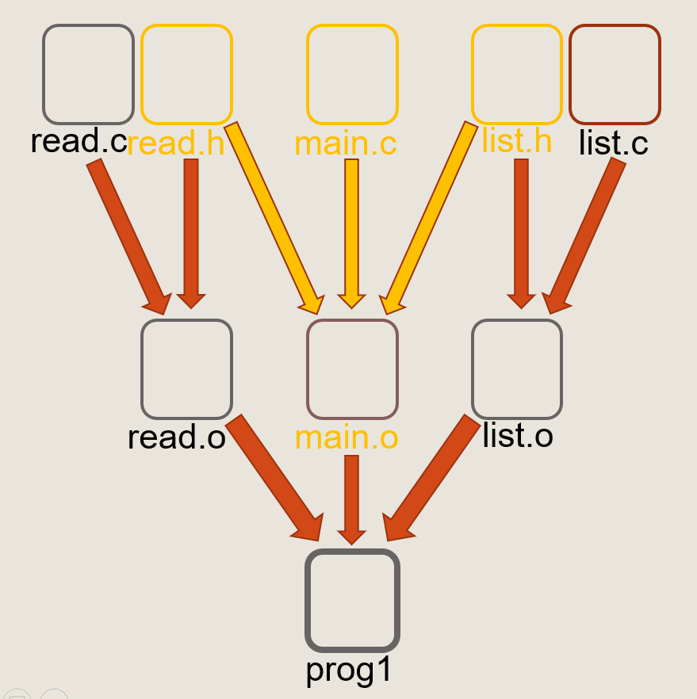
Example
prog1: main.o read.o list.o gcc main.o read.o list.o –o prog1
main.o: main.c read.h list.h gcc -c main.c
read.o: read.c read.h gcc -c read.c
list.o: list.c list.h gcc -c list.c

Slide 15
Example
prog1: main.o read.o list.o gcc main.o read.o list.o –o prog1
main.o: main.c read.h list.h gcc -c main.c
read.o: read.c read.h gcc -c read.c
list.o: list.c list.h gcc -c list.c
Running make: make prog1
If read.h modified: Check prog1
Check: main.o
Do: gcc -c main.c
Check read.o
Do: gcc -c read.c
Check: list.o Do: <nothing>
Do: gcc main.o read.o list.o –o prog1

Slide 16
Comments
# comments are easy

Slide 17
Variables/MACROS
Make maintains variables
Case sensitive
Traditionally – use capital letters
Many automatically defined with default values.
FOO = 1
CFLAGS = -Wall
TARGETS = list.o main.o read.o
Rules can use variables
main.o: main.c read.h list.h
gcc $(CFLAGS) –c main.c

Slide 18
Automatic Variables
Set automatically by make, depend on current rule
$@ - target
$^ - list of all the prerequisites
including the directories they were found
$< - first prerequisite in the prerequisite list.
$< is often used when you want just the .c file in the command, while the prerequisites list contains many .h too
$? - all the prerequisites that are newer than the target
Many Others …….

Slide 19
Using Wildcards
Automatic Wildcard (*,?) expansion in:
Targets
Prerequisites
Commands
clean:
rm -f *.o # good
objects = *.o # no good

Slide 20
Implicit Rules
When no explicit rule defined, an implicit rule will be used.
not always sufficient (e.g. doesn’t check .h files update)

Slide 21
Implicit Rules
We saw “explicit rules” so far, e.g: list.o: list.c list.h gcc -c list.c
Implicit rules (many kinds):
Built-in - create “.o” files from “.c” files.
foo: foo.o bar.o gcc –o foo foo.o bar.o
No need to tell make to create o from c
If we would like to write this explicitly (not needed!)
%.o : %.c
gcc –c $< # -o $@ $@ - file for which the match was made (e.g. list.o) $< - the matched dependency (e.g. list.c)
Notes:
The o are built from c using $(CC) -c $(CFLAGS) $(CPPFLAGS) $< -o $@.
These variables have default values.

Slide 22
Implicit Rules
We can write:
prog1: main.o read.o list.o gcc main.o read.o list.o –o prog1
main.o: read.h list.h
read.o: read.h
list.o: list.h
The dependencies of main.o on main.c are specified in the rule, and also the command to build them.
Notes:
לא צריך לציין במפורש שקובץ O תלוי בקובץ C בעל שם זהה. הmake יבין את זה לבד ובמידה וימצא שינוי הוא ייצור מחדש את קובץ הO מקובץ C עם השם זהה.

Slide 23
Implicit Rules
One more example for implicit rule: %.class: %.java javac $<
Result: For every “.java” file that was modified, a new “.class” file will be created.

Slide 24
Automatic dependencies
gcc know to resolve dependencies:
$ gcc –MM main.c
main.o: main.c read.h list.h
Automatic add dependencies to the makefile:
gcc -MM *.c >> makefile
Also read on: makedepend
Notes:
הפקודה gcc עם הדגל –mm מדפיסה רשימה של תלויות לקובץ מבוקש.

Slide 25
Makefiles: all, clean, .PHONY
#Makes all progs
all: prog1, prog2
command
...
# Not really file names
.PHONY: clean all
# Removing the executables and object files
clean:
rm prog1 prog2 *.o
.PHONY – not really a file name.
Notes:
.PHONY מכיל אחריו, כתנאים מקדימים, רשימה של כל ה"חוקים" שהם לא באמת שמות של קבצים.
אם למשל נעשה חוק שנקרא clean, כל עוד אין קובץ בשם הזה הפקודה תתבצע כראוי. אבל אם וכאשר יווצר קובץ כזה, מאחר ואין לו תנאים מקדימים, הוא תמיד ישאר מעודכן והפקודה make clean לא תבצע שום פעולה.

Slide 26
Automatic makefiles
Many modern IDEs there is no need to write makefiles. They are created for you (eclipse, Visual studio)
It is good to understand what's going on when compiling. So, write your own makefiles

Slide 27
Libraries

Slide 28
Libraries
A library is a collection of code (functions, global variables, etc.) written (sometimes also compiled) by someone else, that you may want to use
Examples:
C’s standard libraries
Math library
Graphic libraries

Slide 29
Compiled Libraries
Compiled libraries may be composed of many different object files

Slide 30
Compiled Libraries
Static libraries:
linked with your executable at compilation time
standard unix suffix: .a (windows: .lib)
Shared libraries:
loaded by the executable at run-time
standard unix suffix: .so (windows: .dll)

Slide 31
Static libraries – first pass
Using the static library libdata.a:
gcc object1.o -ldata -o prog
Creating the library data.a (2 commands):
ar rcu libdata.a data.o stack.o list.o ranlib libdata.a
ar is like tar – archive of object files
ranlib builds a symbol table for the library
to be used by the linker
Notes:
Ar – פקודה לעבודה עם הארכיון.
rcu – דגלים.
r – להכניס קבצים חדשים או להחליף קבצים קיימים בארכיון
C – מבטל אזהרה אם יש צורך ליצור את התקייה
u – להחליף רק קבצים מעודכנים יותר ממה שקיים בארכיון
s – ליצור אינדקס לארכיון.

Slide 32
static vs. shared
Static libraries pros:
Independent of the presence/location of the libraries
Less linking overhead on run-time
Shared libraries pros:
Smaller executables
Multiple processes share the code
No need to re-link executable when libraries are changed
The same executable can run with different libraries
Dynamic Library Loading (dll) possible

Slide 33
static vs. shared
The same executable can run with different libraries
BEWARE: dll hell: exectuables running with
incorrect versions of the library,
to unexpected results…

Slide 34
Libraries in makefile
libdata.a: ${LIBOBJECTS}
ar rcu libdata.a ${LIBOBJECTS}
ranlib libdata.a
OBJECTS = foo.o bar.o
CC = gcc
prog: ${OBJECTS} libdata.a
${CC} ${OBJECTS} –ldata –o prog

Slide 35
Static libraries – second pass
#include <util.h> // Library header int main () { foo(); // foo is a function of the
// 'util' library ... }

Slide 36
Static libraries – second pass
Compilation:
gcc -Wall -c –I /usr/include/myCode/
main.c –o main.o
Linking:
gcc main.o -L /usr/lib/myLib/
-lutils -o app

Slide 37
The linking process: Objects vs. static libraries
objects:
The whole object file linked to the executable, even when its functions not used.
Two function implementations – will cause error.
Libraries:
Just symbols (functions) which not found in the obj files are linked.
Two function implementations – first in the obj file, and second in library – The first will be used.

Slide 38
Dynamic Libraries
Library creation:
Compilation:
gcc -Wall –fPIC -c utils.c
Linking:
gcc –shared utils.o –o libutils.so
Usage:
Linking to:
gcc –Wall –c –I/usr/lib/include
-L/usr/lib/bin –lutils –o prog
*PIC – position independent code.
** On windows you need __declspec(dllimport) …

Slide 39
Dynamic Libraries
Why do we link at compile time to dynamically linked library?
Not real linking, just to check that linking is possible. Actual linking is done in run time. => Need to know how to find in runtime. Should be in the dynamic library search path. (e.g. c:\windows\system)
True dynamic loading (i.e. browser plugins) service is provided by OS (dlopen on linux, loadlibrary on windows)

